Slide 1
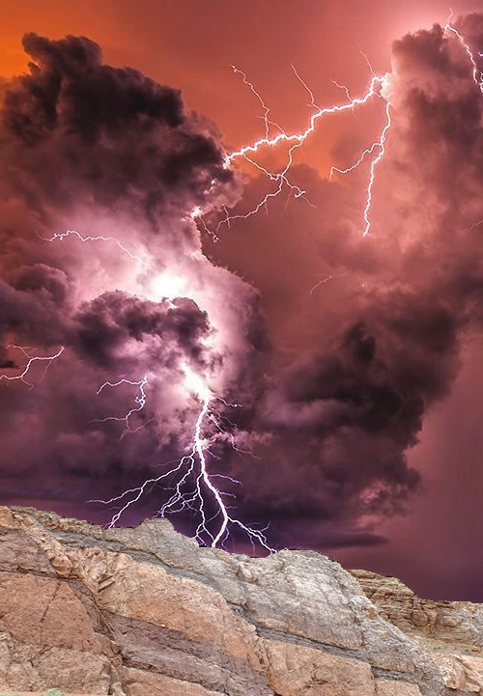
Lightning Analysis A Remote Imaging Exploration Tool
H. Roice Nelson, Jr., Louis J. Berent, Kathleen S. Haggar, Les R. Denham, Dr. Jim Siebert
Dynamic Measurement LLC

Slide 2
Geophysical Service Technologies
Discipline | Technique | Source | Receiver | Power | Remote
Potential Fields | Gravity | Passive | Required | High | Some
Potential Fields | Magnetics | Passive | Required | High | Yes
Electrical Methods | D.C. Resistivity | Required | Required | Low | No
Electrical Methods | Electrical Resistivity Tomography (ERT) | Required | Required | Low | No
Electrical Methods | Induced Polarization (IP) | Required | Required | Low | No
Electrical Methods | Time-Domain IP | Required | Required | Low | No
Electrical Methods | Magnetotellurics (MT) | Passive | Required | Low | No
Electrical Methods | Audio-Frequency MT (AMT) | Passive | Required | Low | No
Electrical Methods | Controlled Source Electromagnetics (CSEM) | Required | Required | Medium | No
Electrical Methods | Transient Electromagnetic Time-Domain EM (TEM) | Required | Required | Low | No
Electrical Methods | Controlled Source Audio Magnetotelluric (CSAMT) techniques | Required | Required | Low | No
Electrical Methods | Frequency-Domain EM Induction | Required | Required | Low | No
Electrical Methods | AquaTrack (leak detection at dams, mines, etc.) | Required | Required | Low | No
Electrical Methods | Borehole Techniques like Self-Potential (SP) | Passive | Required | Low | No
Electrical Methods | Ground Penetrating Radar (GPR) | Required | Required | Low | No
Electrical Methods | Very Low Frequency Methods (VLF) | Required | Required | Medium | No
Electrical Methods | High-Frequency Techniques (radar, etc.) | Required | Required | Low | No
Electrical Methods | Airborne Electromagnetic Systems | Required | Required | Low | No
Electrical Methods | Tipper | Passive | Required | Low | Some
ElectroSeis | ElectroSeis | Passive | Required | Low | No
Seismic | Micro-Seismic | Required | Required | Low | No
Seismic | Earthquake Seismology | Passive | Required | High | Yes
Seismic | Refraction Seismic | Required | Required | Medium | No
Seismic | Reflection Seismic | Required | Required | Medium | No
Satellite | Spatial, Spectral, Temporal, & Geometric Resolution | Passive | Database | Low | Yes
Satellite | Radiometric Resolution: Thermal, Reflectance, Elevation | Passive | Database | Low | Yes
Lightning | National Lightning Detection Network (NLDN) | Passive | Database | High | Yes
Lightning | Global Lightning Database (GLD-360) | Passive | Database | High | Yes
Focus on right column and 8 remote imaging green & yellow technologies

Slide 3
Remote Geophysical Service Technologies
Discipline | Technique | Source | Receiver | Power | Remote
Potential Fields | Gravity | 260 feet (80 m) | Ground, Helicopter, or Satellite | High | Some
Potential Fields | Magnetics | 4,000 ft (1200 m) | Airplane or Satellite | High | Yes
Electrical Methods | Tipper (powered by lightning) | Chile-SLC | Ground or Helicopter | Low | Some
Seismic | Earthquake Seismology | Chile-SLC | Remote Seismographs | High | Yes
Satellite | Spatial, Spectral, Temporal, & Geometric Resolution | 100-22,000 miles | Low, Medium, Geocentric Orbits | Low | Yes
Satellite | Radiometric Resolution: Thermal, Reflectance, Elevation | 160-35,000 kilometers | Low, Medium, Geocentric Orbits | Low | Yes
Lightning | National Lightning Detection Network (NLDN) | Vertically 800-33,000 ft | Horizontally <600 miles (<965 km) | High | Yes
Lightning | Global Lightning Database (GLD-360) | Vertically 0.25-10 km | Horizontally <6,000 miles (<9,650 km) | High | Yes

Slide 4
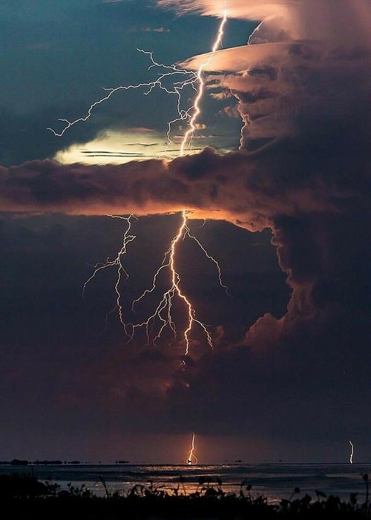
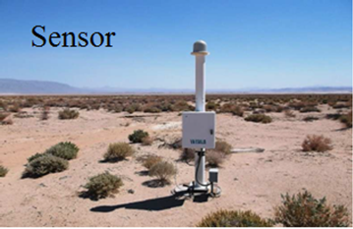
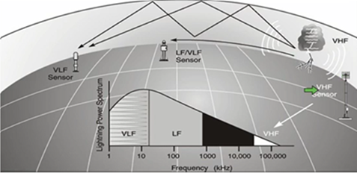
Lightning Analysis The Source & The Receivers
Strike Locations Triangulated & Measurements Reconciled
33,000 feet
600 miles
1,000 miles
800 feet
Vaisala: Martin Murphy
2016 Webinar used with permission

Slide 5
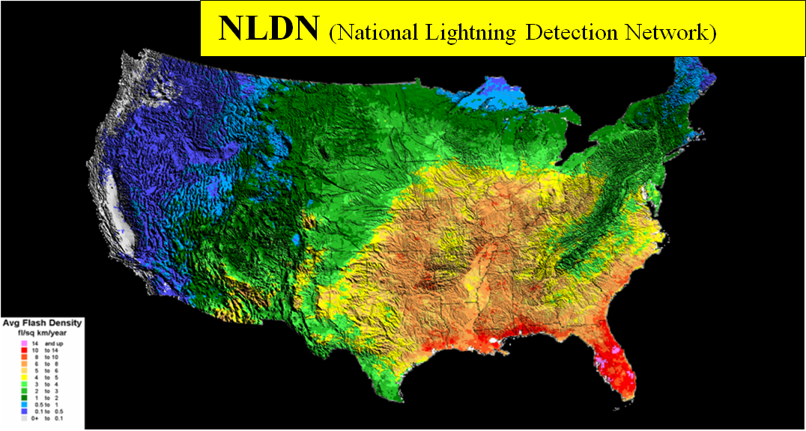
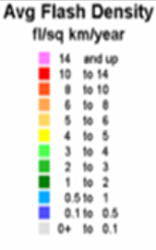
NLDN Lightning Density
Originally Collected for Insurance, Meteorology, and Safety Reasons
Exclusive Lightning Database License for Natural Resource Exploration

Slide 6
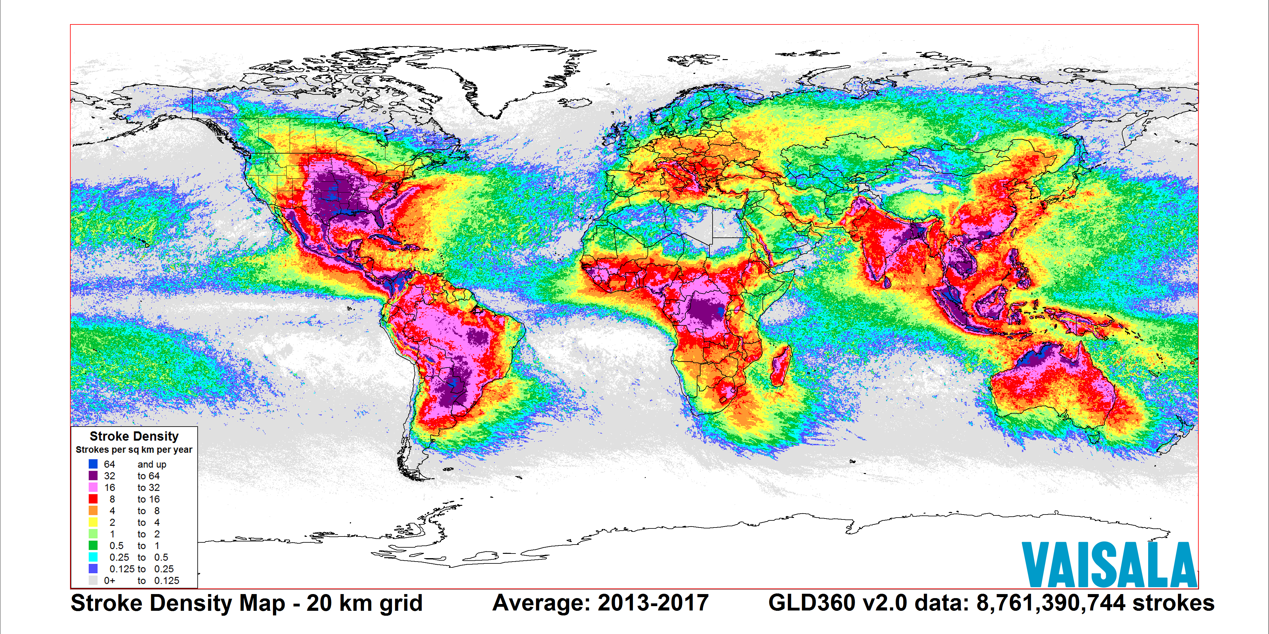
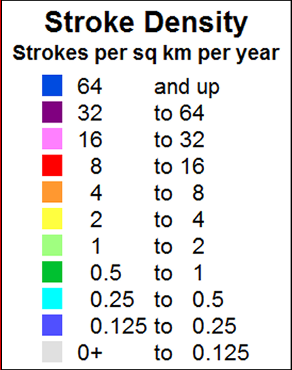
GLD-360 Lightning Density

Slide 7
On a Clear Day the Earth’s Surface is an Equipotential Surface
Telluric Currents (Earth Currents) do not change quickly, because geology does not change over short periods of time.
Atmospheric Currents change, especially with each new electrical storm.
As Atmospheric Currents change, the change induces changes in Telluric Currents.

Slide 8
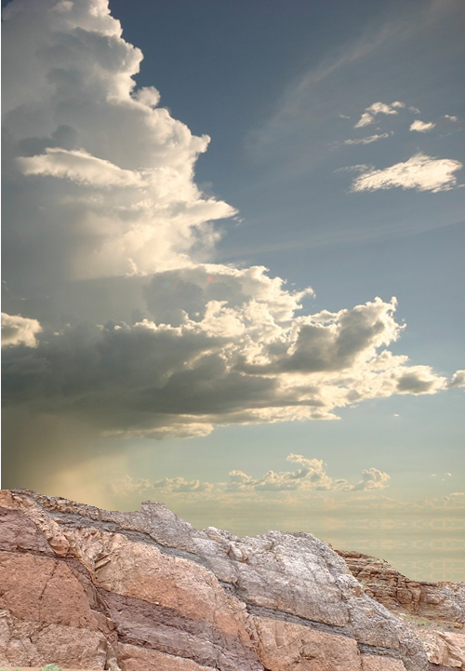
Electrical Charge Builds Up in the Atmosphere over Hours, Minutes, and Microseconds
The earth’s electromagnetic half-space mirrors the atmospheric electromagnetic half-space and wind currents modify thundercloud distribution.
A signal with a period of 24 hertz can have a skin depth of 375-500 miles (600-800 km).
Lightning Strokes last microseconds, and build up over tens of milliseconds, which provides skin depths reaching the Mohorovičić Discontinuity.
Lightning is a key charges of telluric currents.

Slide 9
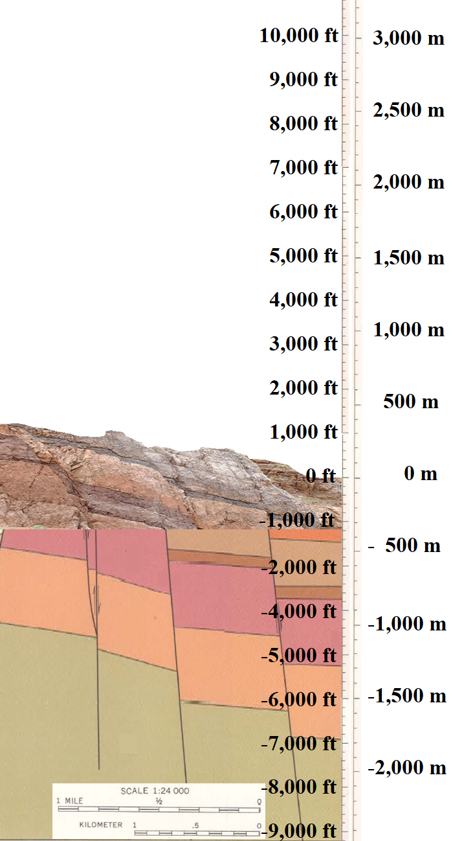
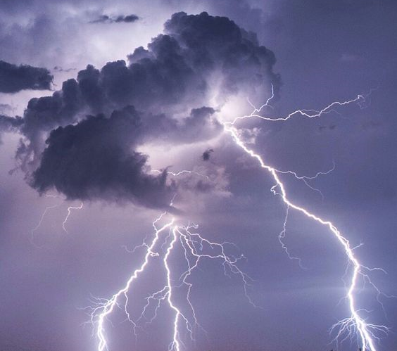
Lightning is a Large Natural Capacitor
Upper Capacitor Plate
Key Assumptions:
Lightning occurs when there is sufficient charge to bridge the atmospheric capacitor.
Lightning is affected by geology to a depth proportional to cloud height, as derived from Peak Current.
Upper Capacitor Plate
Lower Capacitor Plate
Lower Capacitor Plate

Slide 10
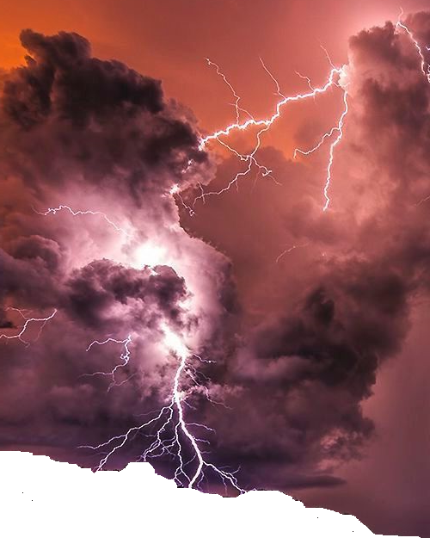
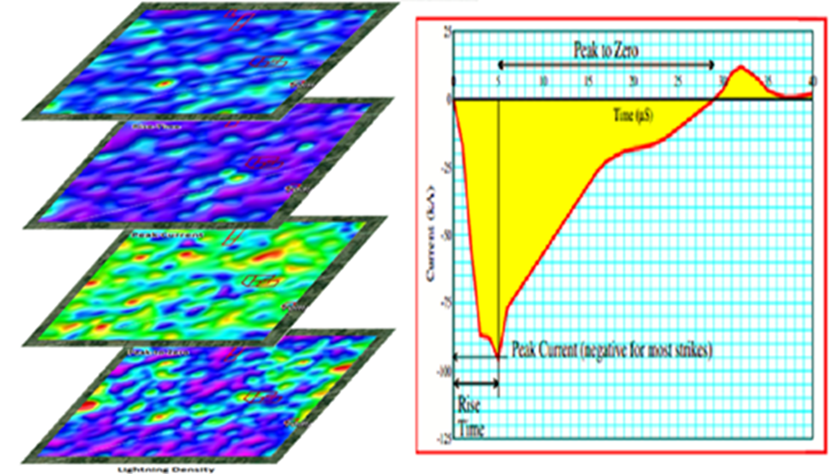
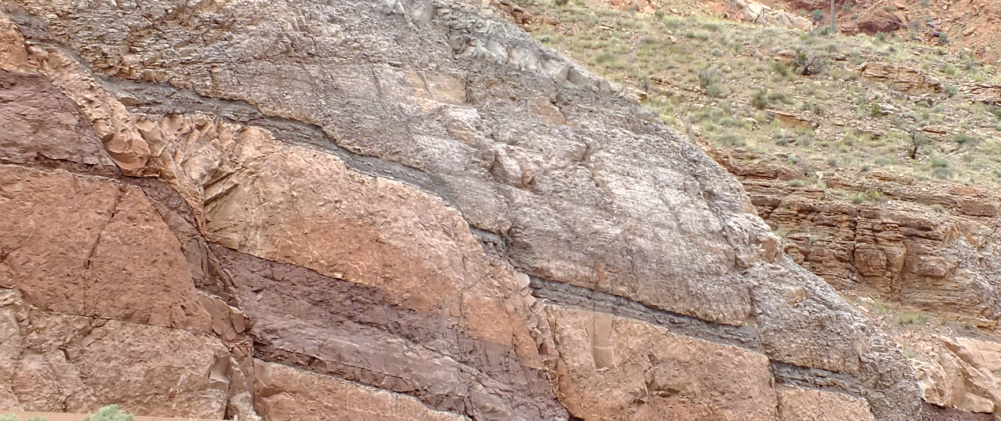
C2C & C2G Strokes Transfer Electrical Energy
C2C: Cloud-to-Cloud discharges between accumulated electrons at the base of cloud and a lack of electrons at the top of the cloud
-
-
-
-
-
-
-
-
+
+
+
+
+
Rise-Time
Peak Current
Peak-to-Zero
Density
Other attributes calculated from these measurements.
Measurements separated by time.
-
-
-
-
-
-
-
-
-
-
-
-
-
-
-
-
-
-
-
-
-
-
C2G:
Cloud-to-Ground discharges between electrons at the base of cloud and a lack of electrons in the earth
-
-
-
-
-
-
-
-
+
+
+
+
+
Lightning Strike Waveform
+
+
+
+
+
+
+
+
+
+
+
+
+
+
+
+
+
+
+
+
+
+
+
+
+
+
+
+
+
+
+
+
+
+
+
+
+
+
+
+
+
+

Slide 11
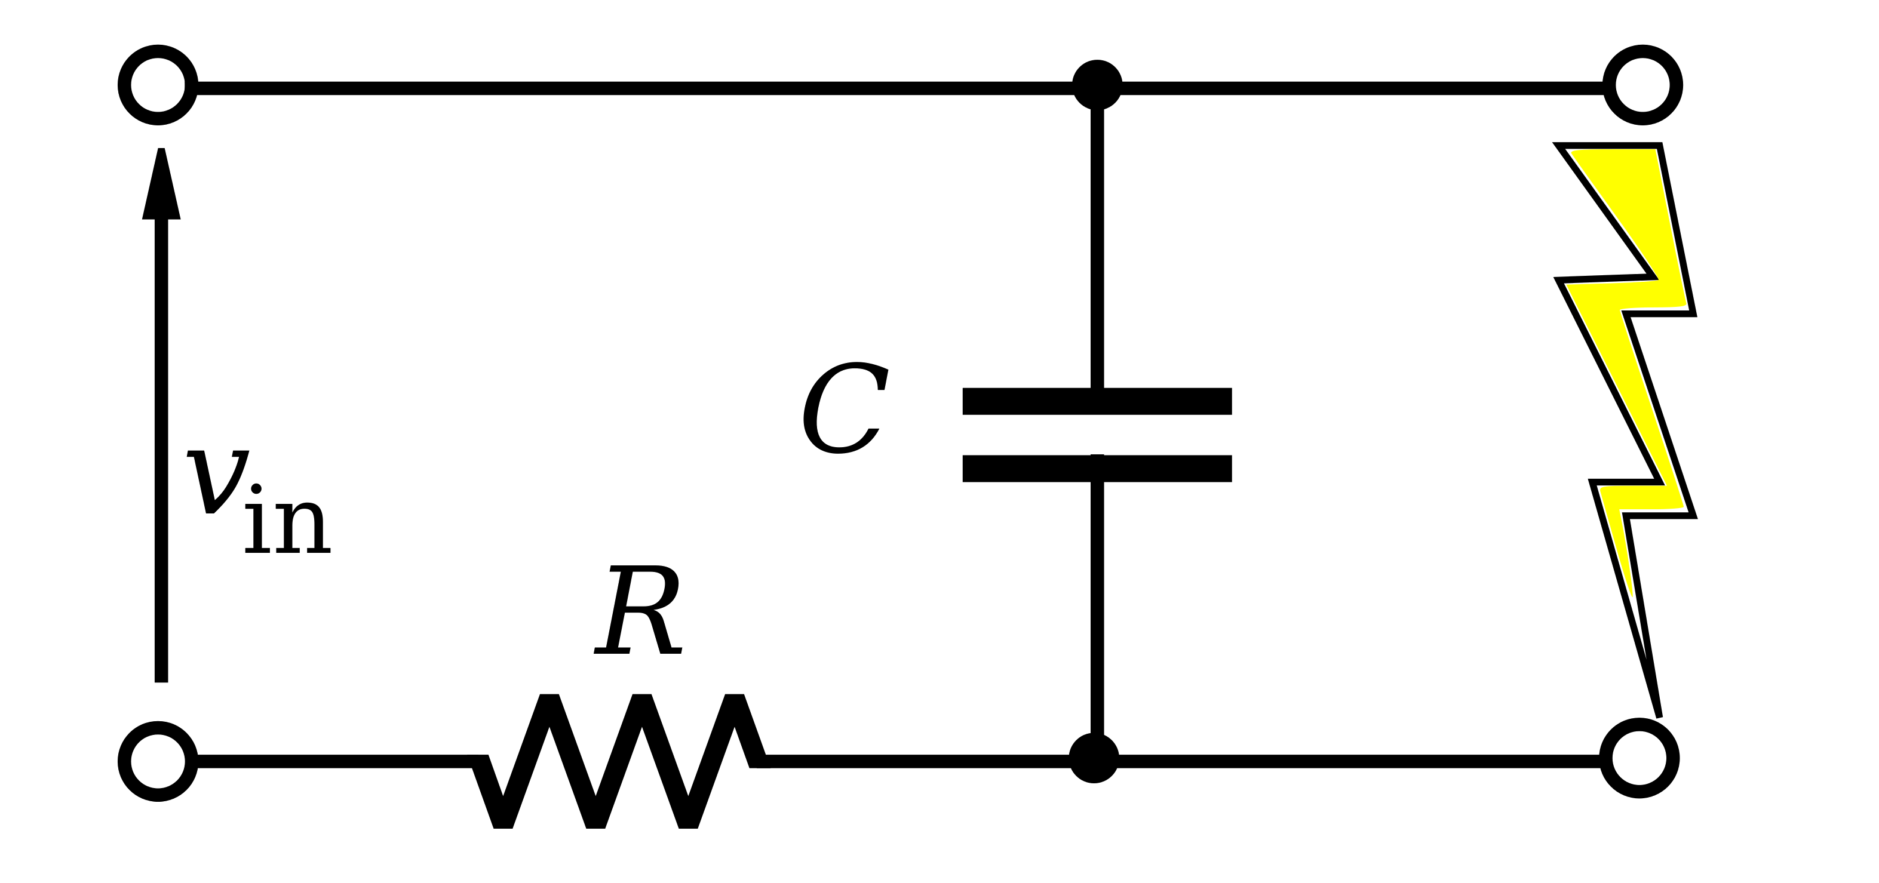
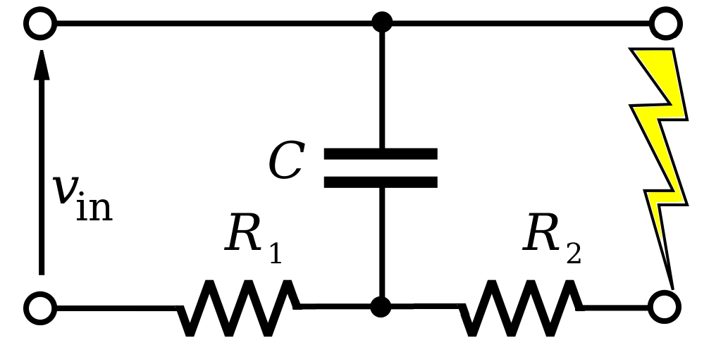
Lightning Strike Mathematics comparable to Neon Light Tube Mathematics
The atmospheric capacitor is like a neon light tube capacitor
Just an additional resistance (R₂) limiting the current
Calculating R₂ provides values for resistivity maps & volumes.
R₁ is resistance governing the time between lightning strokes.
R₂ is the resistance between the lightning strike point and the bottom plate of the capacitor, i.e. the resistance of the rocks and the fluids in the rocks.

Slide 12
Dynamic Identifies Lightning Risk Points

Slide 13
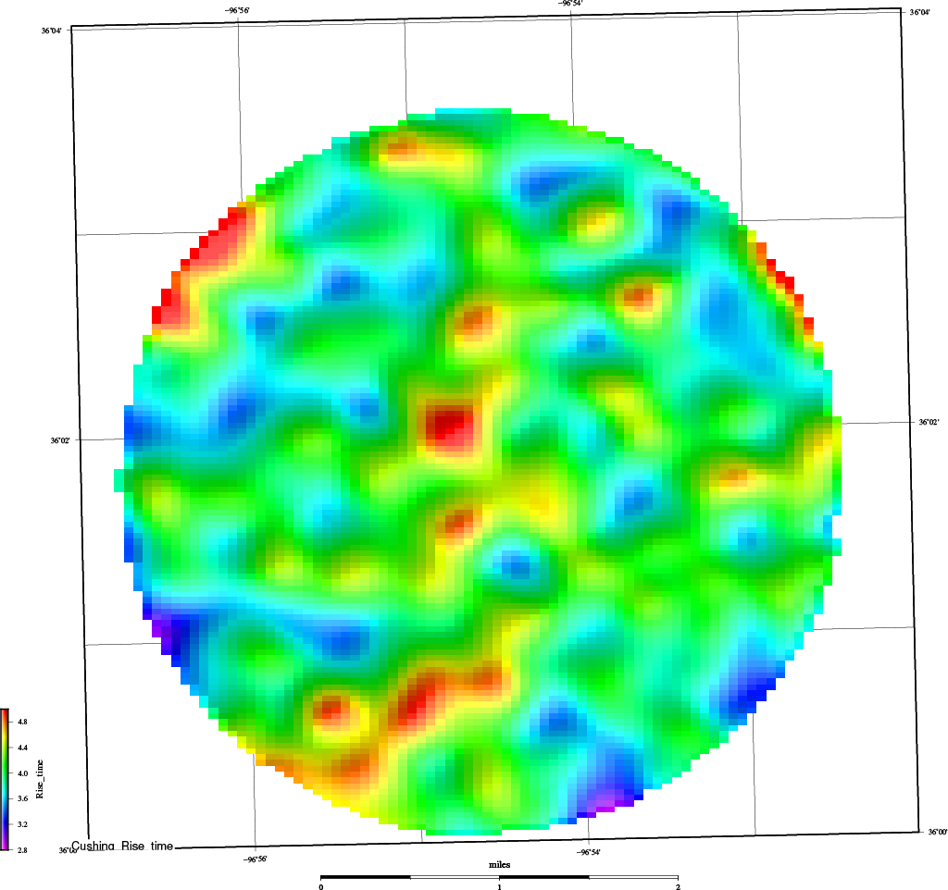
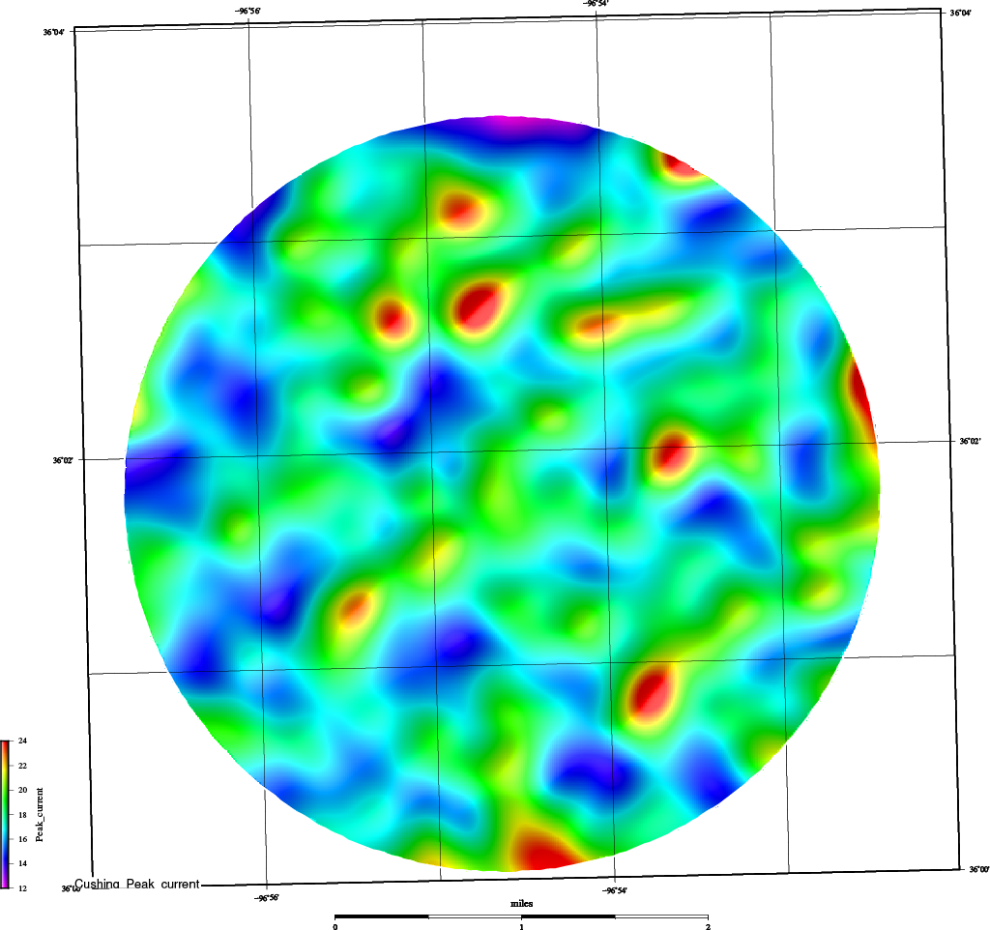
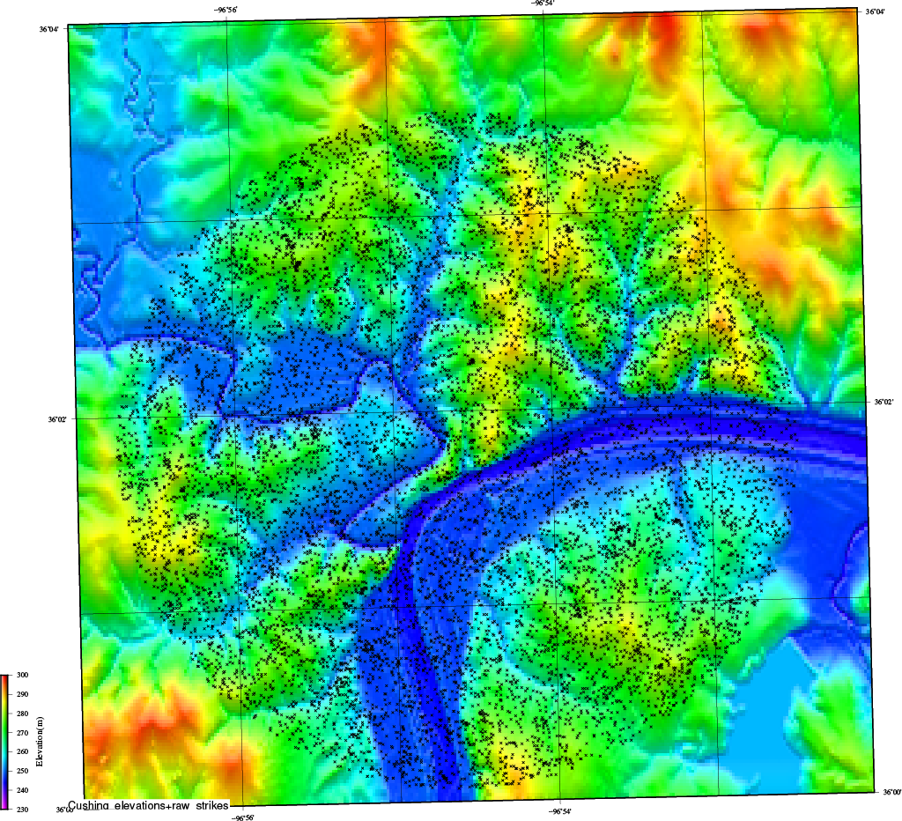
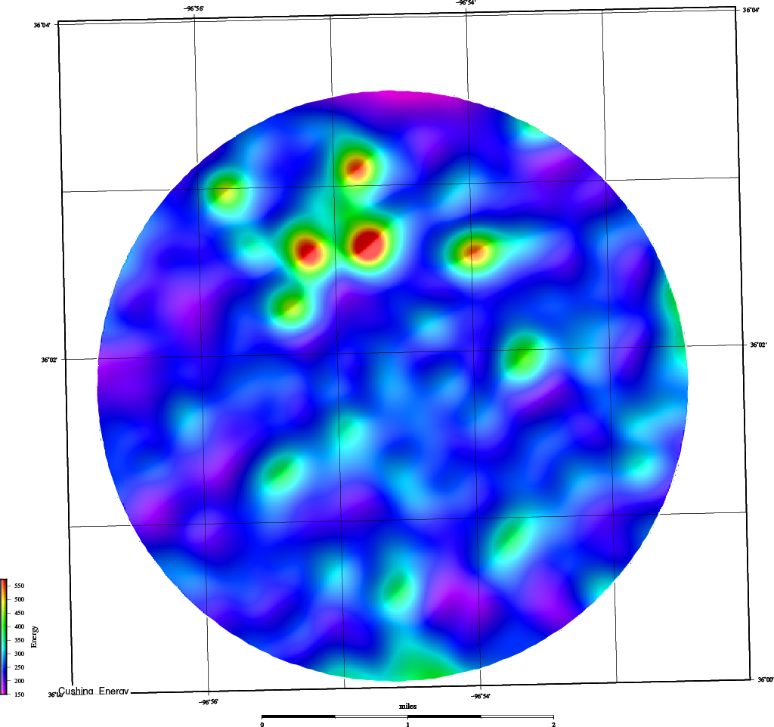
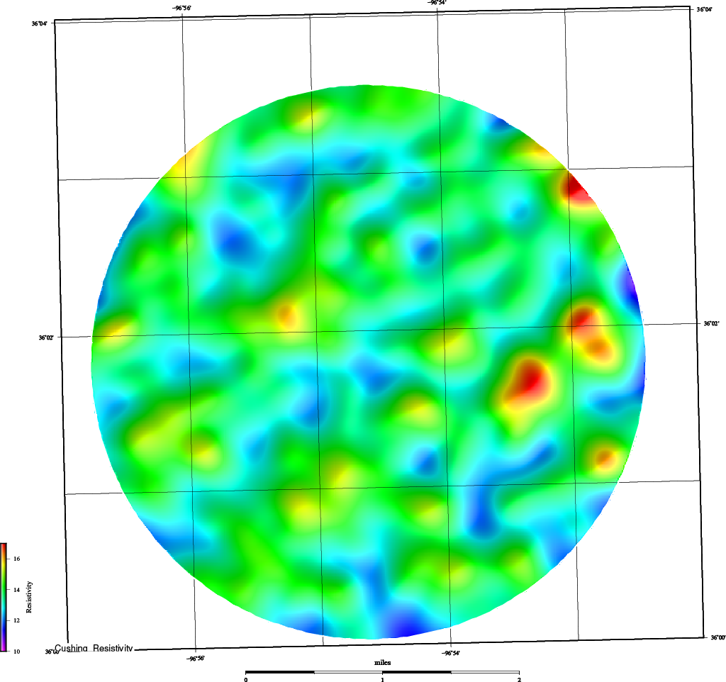
Oklahoma Lightning Maps
Peak
Current
Rise-Time
Strike Locations over Topography
Energy
Apparent Resistivity

Slide 14
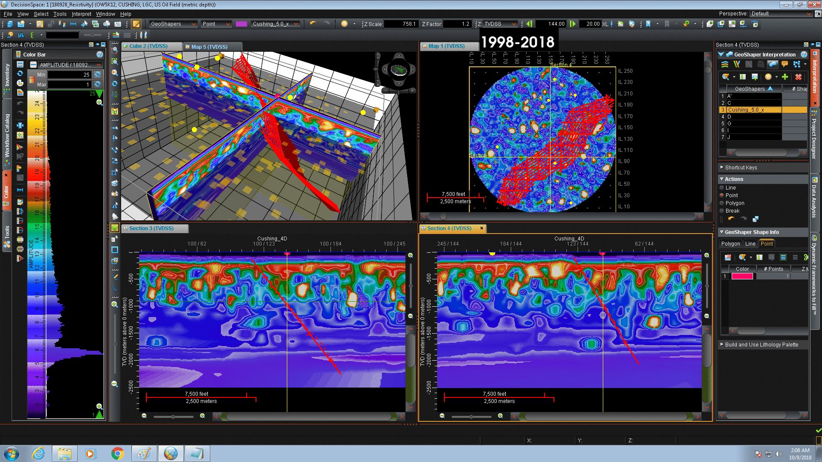
Cushing Oklahoma Time-Lapse Apparent Resistivity

Slide 15
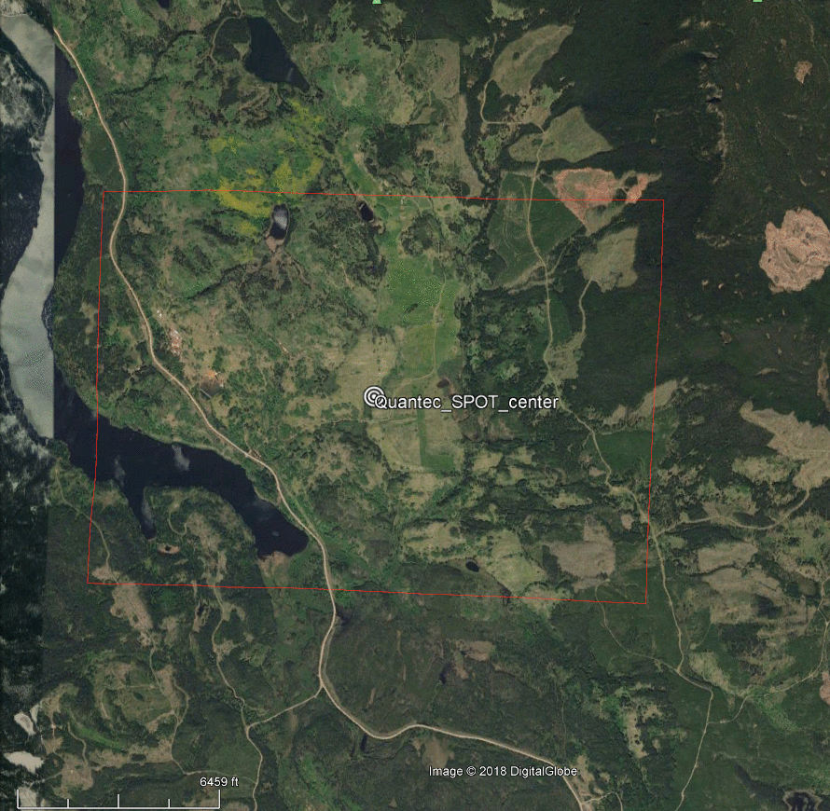
British Columbia Mine Overview

Slide 16
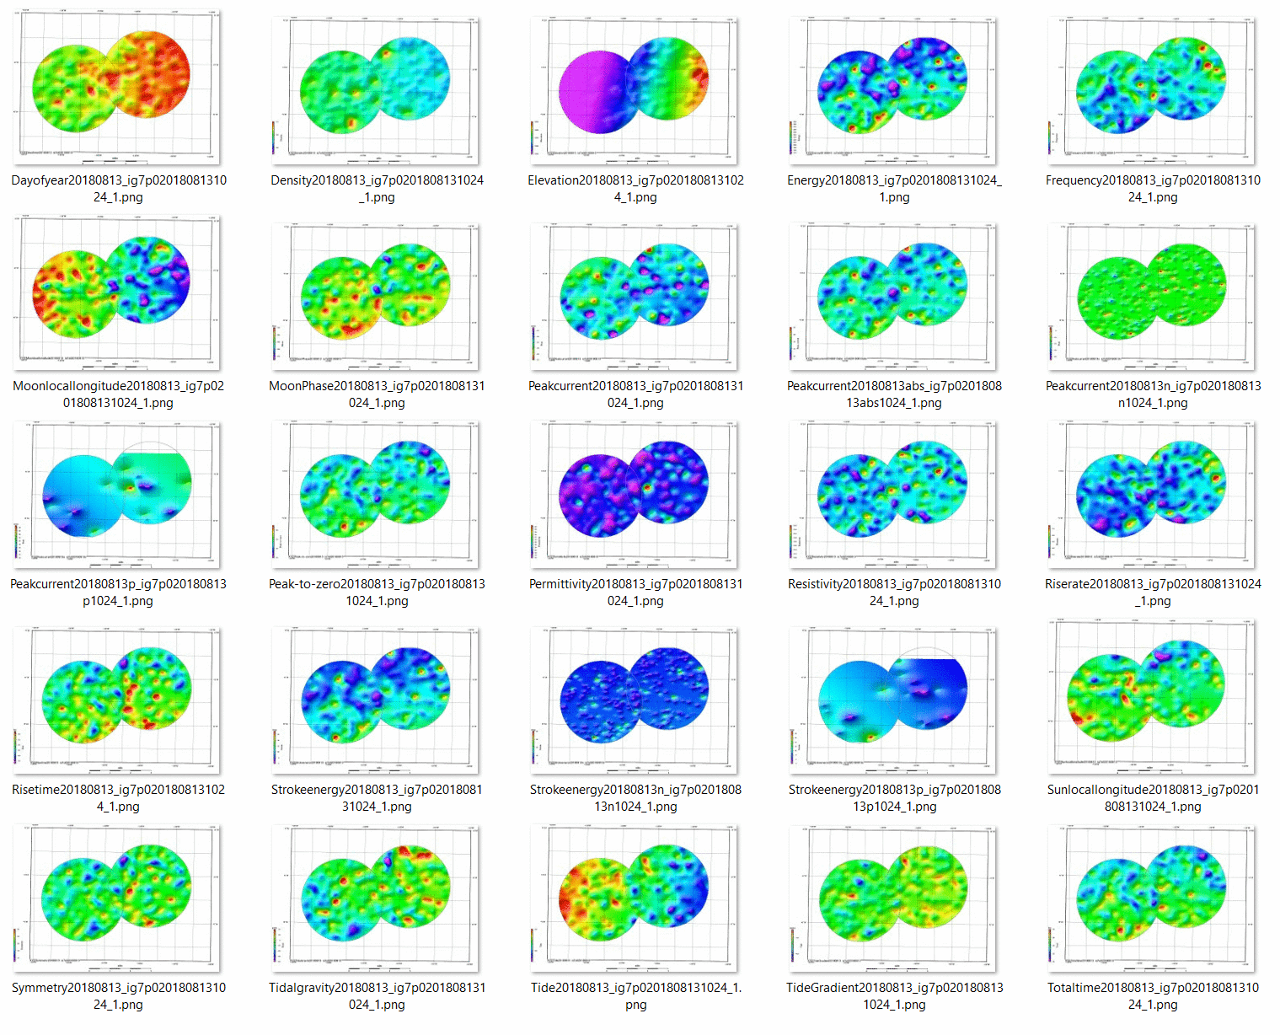
North Nevada Lightning Attribute Maps

Slide 17
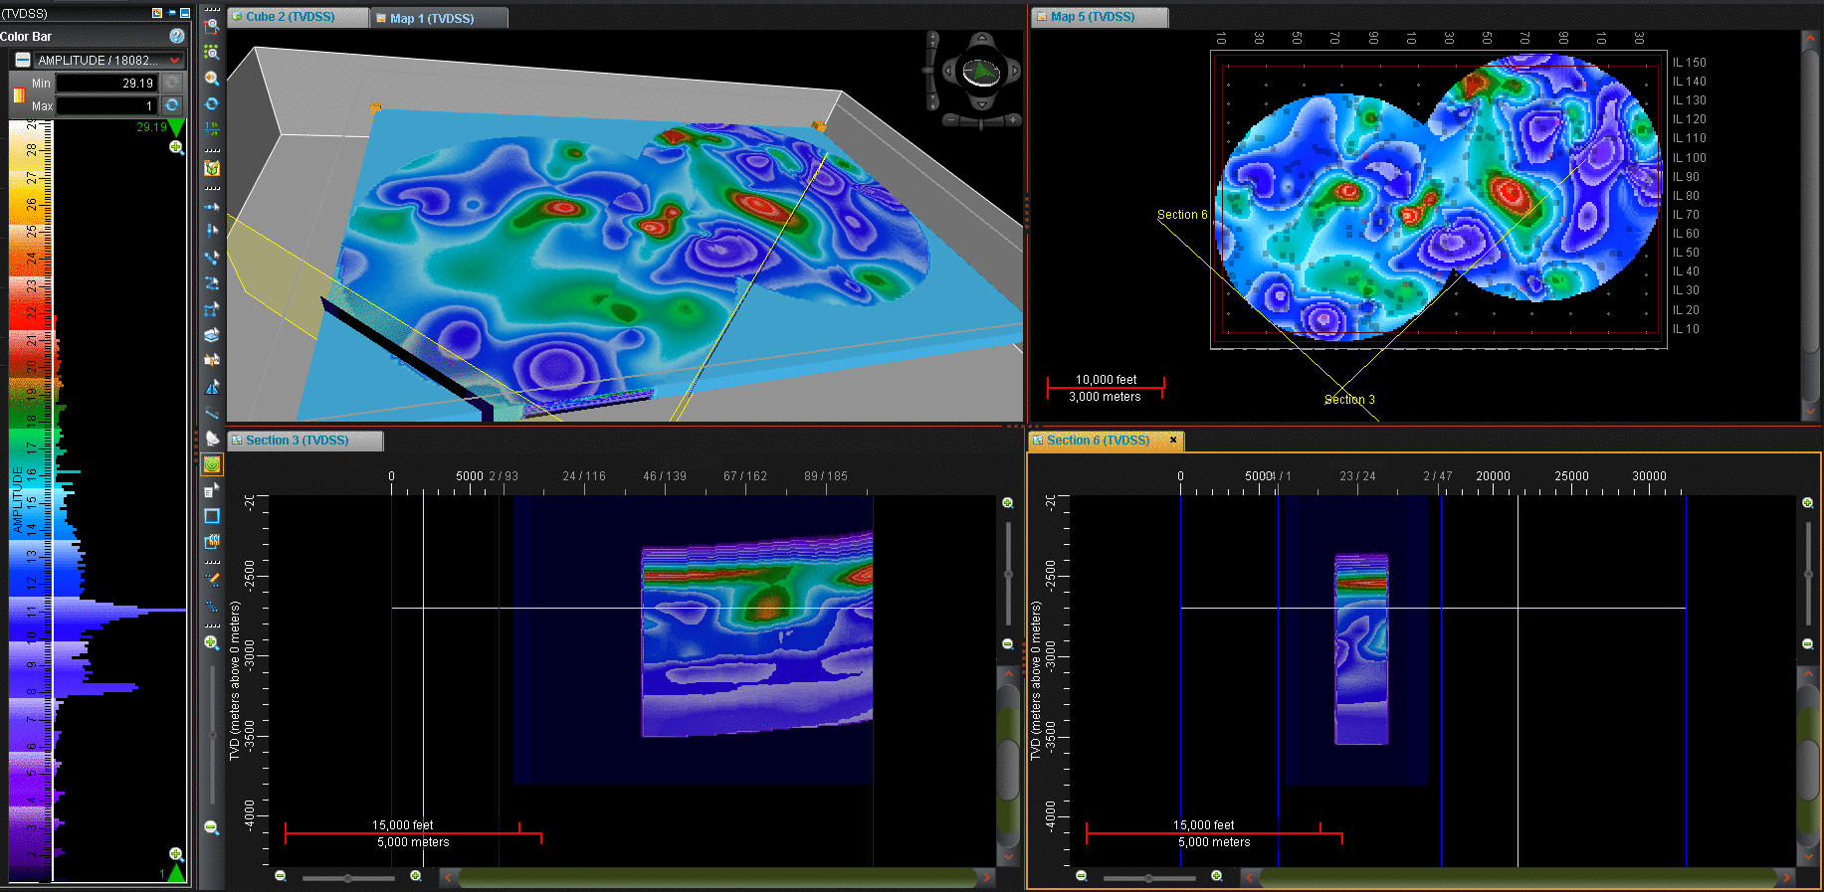
North Nevada Interpretation

Slide 18
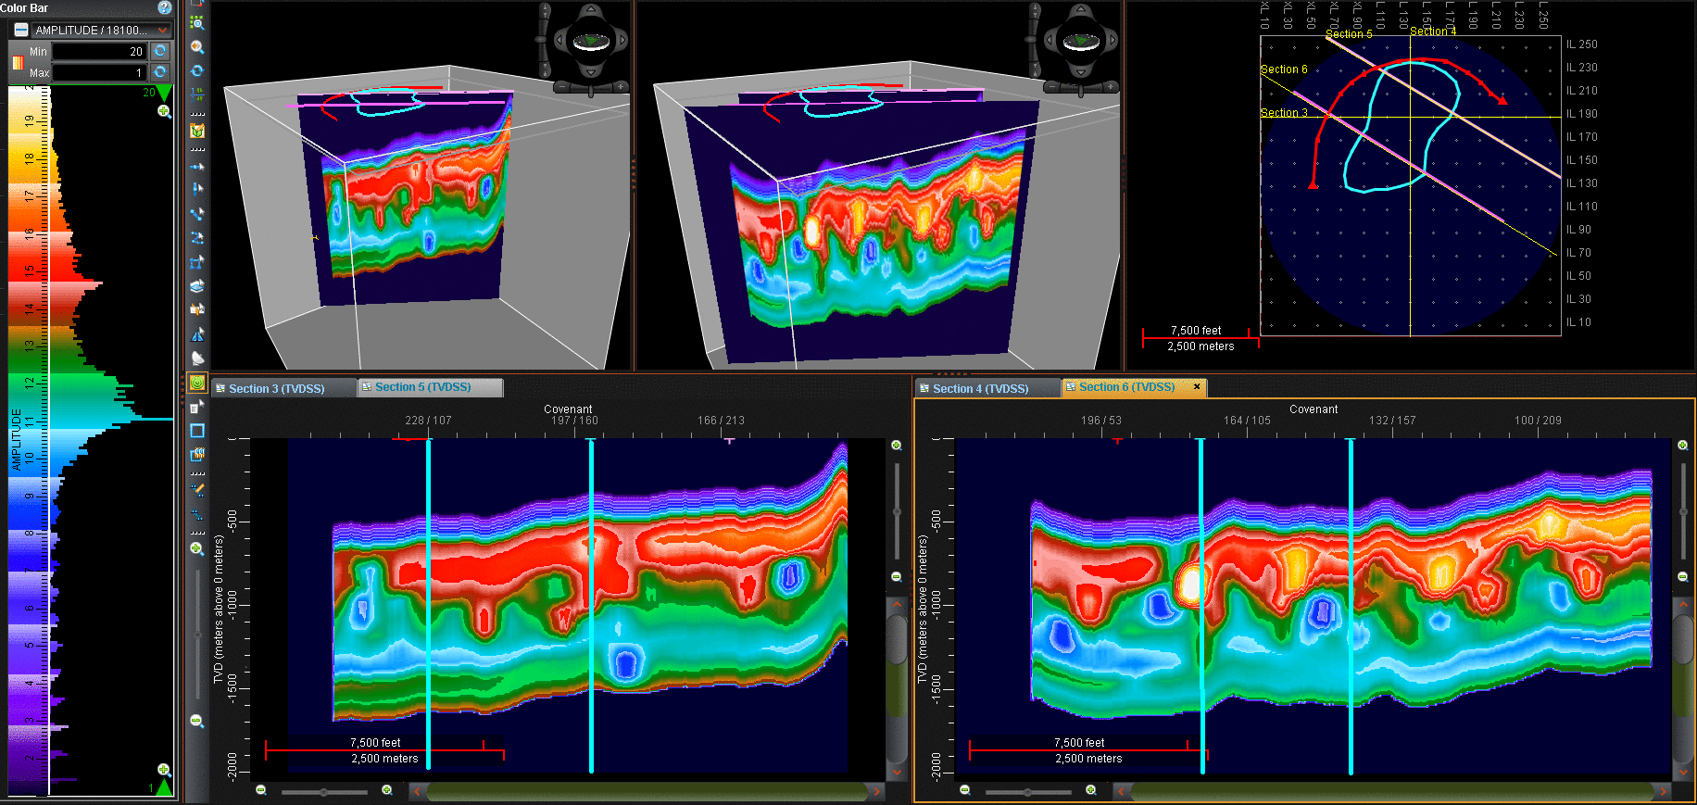
Covenant Field, Utah Volumes

Slide 19
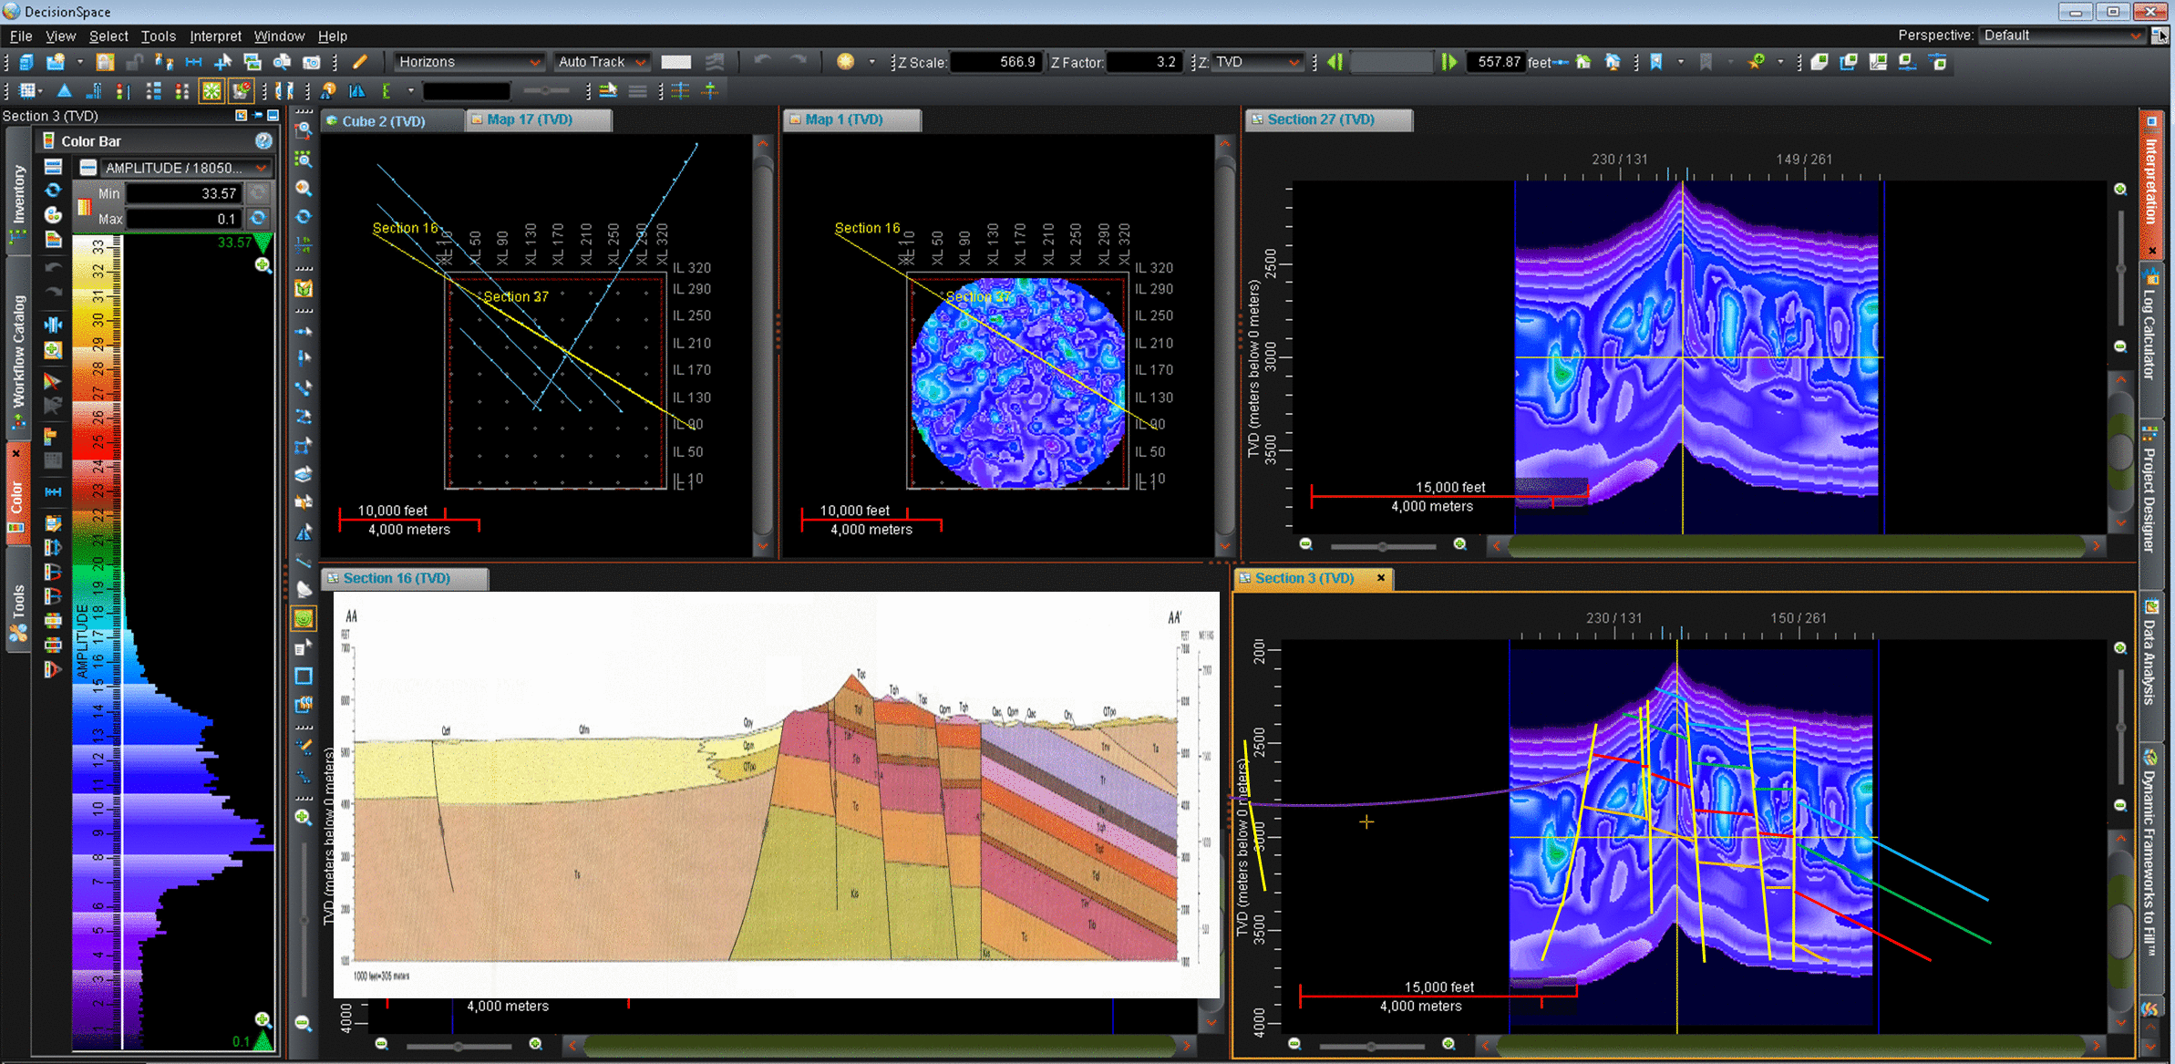
South Utah Interpretation

Slide 20
Conclusions
Lighting strike locations are impacted by geology.
Lightning strikes clusters are predictable from historical data.
Randomizing lightning strike cell locations create a different distribution than raw data. Differences in these distributions are due to geologic influences on locations.
Skin depth of lightning electrical energy is tied to the build-up of storms and charges telluric currents at exploration depths.
Rock properties, apparent resistivity and apparent permittivity, can be calculated from lightning strike databases.
Rock properties and lightning attributes distributions displayed as maps, as volumes, & interpolated to match existing or planned geophysical surveys, filling-the-gaps.
These maps and volumes allow the creation of geotechnical frameworks – faulting & resistivity anomalies & sweetspots, as shown in Oklahoma, British Columbia, North Nevada, Central Utah, and South Utah examples.

Slide 21
Contact Dynamic Measurement
Acknowledgements
OGS, LTI, and Renewable Energies for permission to show their lightning analysis projects, and Dynamic Measurement for support.
http://www.dynamicmeasurement.com Website
roice@dynamicmeasurement.com Roice Nelson 713.542.2207
ljberent@dynamicmeasurement.com Louie Berent 832.352.3795

